Slide 1


Board of Directors Meeting
Wednesday, January 14, 2026
_______________________
Embassy Suites Hotel
Brookfield, WI
Wifi: xxxxxx
Password: xxxxx

Slide 2
Welcome & Introductions
Welcome New Directors
Angela Kallay
Sheena Polachowski
Casey Clickner
Beau Mitcham

Slide 3

GMAR Finances
Johnson Financial Group
Michael Cox, SVP Portfolio Manager

Slide 4
Consent Agenda
January 14, 2026 BOD Meeting Agenda
October 15, 2025 BOD Meeting Minutes
Approve of 122 New Members

Slide 5
Reports
Chairman, Tom McCormick
Looking forward to 2026!

Slide 6
Reports
GMAR Financials
2025 GMAR Audit
To begin in March, presentation at April BOD
New iMIS membership/accounting system
November 2025 Financials

Slide 7
November Financials

Slide 8
November Financials

Slide 9
November Financials

Slide 10
November Financials
Balance Sheet
Total Current Assets: $3.5m, up $570K
Total Assets: $5.5m, up $672K
Total Liabilities: $2.2m, up $512K
Total Net Assets: $3.2m, up $160K

Slide 11
November Financials
Statement of Activities
Membership: 2025 dues ahead $125K (revenue up because of $40 dues increase, despite # of members down compared to 2024)
Promotions: HGS $272K

Slide 12
November Financials
Statement of Activities
Public Policy & Administration: Expenses primarily labor & overhead
Leadership: Travel to NAR events
Bottom Line: $651,686 vs. $585,210 in 2024

Slide 13
President’s Report
Bylaws Change
Article XI Officers and Directors
Section 8. Executive Roundtable Election of Directors.
(a) The members of the Executive Roundtable shall be one (1) REALTOR® owner or corporate officer who holds primary membership in the Association and whose firm is among the top ten (90) (10) firms as determined in December January of each year based upon the total number of primary REALTOR® members in this Association under the firm’s broker license.
(1) Commencing in the year 2001 and no later than December 31st January 31st of each year, the Executive Roundtable shall elect one of its members to serve a three (3) year term as one of the five (5) new Directors elected to the Board of Directors for the following year.

Slide 14
President’s Report
Bylaws Change
Article XI Officers and Directors
Section 3. Board of Directors. The governing body of the Association shall be a Board of Directors (herein referred to as “Board,” “Board of Directors,” or “Directors”) consisting of fifteen (15) Directors, which shall include the elected Officers, all of which shall have the right to vote on issues before the Board. Five (5) new Directors shall be elected each year to serve for terms of three (3) years. Of those five (5) new Director vacancies, the voting Members shall elect Directors to four (4) of the new Director vacancies and any vacancy from an unexpired term of a Director. The remaining one (1) new Director vacancy shall be selected by the Executive Roundtable. In the event there is a vacancy of an unexpired term for a Director selected by the Executive Roundtable, that vacancy shall also be selected by the Executive Roundtable.

Slide 15
President’s Report
Board of Director Positions
Abby Hauke to fill Sarah Venes position
Two Executive Roundtable positions available
January 20th run census of GMAR to determine which firms comprise the top 10

Slide 16
President’s Report
DiscoverMilwaukee.com
Karen Brienzo has started soliciting sponsors
Our original plan was to generate some revenue, then update the site in WordPress
Plan B is to create a new site ASAP, $4,000 to have Markt convert it

Slide 17
President’s Report
Tether RE
Subscriptions are not going well
Last summer’s survey was encouraging
We’re hitting the survey takers
Also focusing on security in light of recent crime, threats against REALTORS®

Slide 18
President’s Report
SentriLock
The New SentriLock is here: 1/1/2026 – 12/31/2032
$12.54 per user, 3,250 users
1-5 lockboxes can keep original allotment
6+ looked at average listings and current actives
Teams with 12+ were emailed asking what they need. Most downsized their box inventory about 20%

Slide 19

Department Reports
Professional Standards

Slide 20

Department Reports
Government Affairs

Slide 21
Department Reports
Government Affairs
Spring 2026 Elections
Primary: February 17th
General: April 7th
RPAC/Direct Giver Fundraising
Feb. 25th Bucks vs. Cavs in Club Lounge
May 7th RPAC Auction, Bibingers

Slide 22

Department Reports

Slide 23
Department Reports
625 booths available, 458 sold (74%), 165 left
Entire WSFP Expo Center
VIP Ticket program is live, reduced cost to members
Yutka Fence Puppy Pit
$62,000 in sponsorships (Budgeted $50K)
Antique appraisals are back! Friday 3/27- Sunday 3/29
Melinda Meyers both weekends

Slide 24

Department Reports

Slide 25
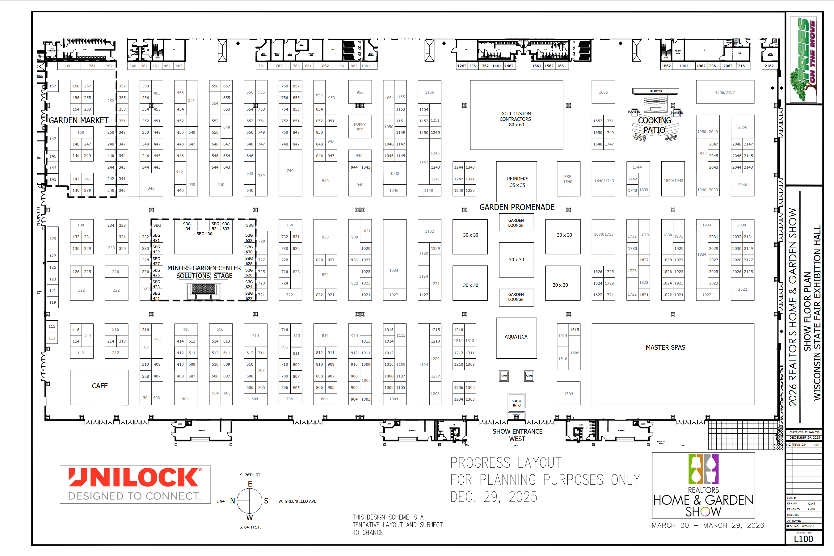
Department Reports

Slide 26



Metro MLS
Chris Lambrou, CEO
MLS Update

Slide 27
Old Business / New Business
Old Business
None
New Business
MLS Discussion

Slide 28


Post-Packers Depression?
2026 Winter Olympics
February 6th – 22nd
Kewasukum’s Own Jordan Stolz
41-year old Lindsey Vonn

