Slide 1


Board of Directors Meeting
Thursday, April 16, 2026
_______________________
Metro MLS Headquarters
Wauwatosa, WI
Wifi: Metro_Guest
Password: SuperNova8534

Slide 2
Greater Milwaukee Association of REALTORS®
    1. Welcome & Introductions
      Guest: Tom Larson, WRA CEO (Zoom)
    2. Consent Agenda
Wifi: Metro_Guest Pwd: SuperNova8534

Slide 3
Greater Milwaukee Association of REALTORS®
    3. Reports
      Chairman, Tom McCormick
      GMAR Financials
        January Financial Statements
Wifi: Metro_Guest Pwd: SuperNova8534

Slide 4
Greater Milwaukee Association of REALTORS®
January Balance Sheet
Total Current Assets: $3.8m, up $804K
Total Assets: $5.8m, up $963K
Total Liabilities: $515Km, up $414K (due to GMAR Mortgage)
Total Net Assets: $5.3m, up $595K
Wifi: Metro_Guest Pwd: SuperNova8534

Slide 5
Greater Milwaukee Association of REALTORS®
January Statement of Activities
Membership: 2026 renewals were 23,632 ahead of 2025.
Promotions: HGS Budgeted $242K. Looks like we exceeded that number.
Wifi: Metro_Guest Pwd: SuperNova8534

Slide 6
Greater Milwaukee Association of REALTORS®
January Statement of Activities
Public Policy & Administration: Expenses primarily labor & overhead
Leadership: Travel to NAR events
Bottom Line: $2,327,630 vs. $2,137,741 in 2025, +189,889
Wifi: Metro_Guest Pwd: SuperNova8534

Slide 7
Greater Milwaukee Association of REALTORS®
President’s Report
NAR Wins Numerous 3-Way Agreement Challenges
$7,500 NAR Housing Opportunity Grant for Ozaukee County Economic Development
Wifi: Metro_Guest Pwd: SuperNova8534

Slide 8
Greater Milwaukee Association of REALTORS®
Bylaws Change
Article XI Officers and Directors
Section 3. Board of Directors. The governing body of the Association shall be a Board of Directors (herein referred to as “Board,” “Board of Directors,” or “Directors”) consisting of fifteen (15) Directors, which shall include the elected Officers, all of which shall have the right to vote on issues before the Board. Five (5) new Directors shall be elected each year to serve for terms of three (3) years. Of those five (5) new Director vacancies, the voting Members shall elect Directors to four (4) of the new Director vacancies and any vacancy from an unexpired term of a Director. The remaining one (1) new Director vacancy shall be selected by the Executive Roundtable. In the event there is a vacancy of an unexpired term for a Director selected by the Executive Roundtable, that vacancy shall also be selected by the Executive Roundtable.
Wifi: Metro_Guest Pwd: SuperNova8534

Slide 9
Greater Milwaukee Association of REALTORS®
Board of Director Positions
    Executive Roundtable positions
      Nichole Barowski, Homestead Realty
      Abby Hauke, Realty Executives Integrity
      Stephanie Conard, Keller Williams
    Scott Klaas: Move to Abby Hauke’s vacant seat
Wifi: Metro_Guest Pwd: SuperNova8534

Slide 10
Greater Milwaukee Association of REALTORS®
SentriLock
    January’s transition went well
    About 1,000 old boxes are still out there
    No longer under warranty, so there is incentive to bring old boxes in
Wifi: Metro_Guest Pwd: SuperNova8534

Slide 11
Greater Milwaukee Association of REALTORS®
DiscoverMilwaukee.com
    Transitioning from Drupal to WordPress
    Integrated GMAR blog, cleaning up old info
    35,000 users in 2025, about 700 visitors/week
    Karen is now shifting to selling advertising and reaching out to potential partners
Wifi: Metro_Guest Pwd: SuperNova8534

Slide 12
Greater Milwaukee Association of REALTORS®
Tether RE
    Subscriptions are in the doldrums
    Went after survey takers
    Focusing on security
    Going to call manager after manager, visit offices, etc.
Wifi: Metro_Guest Pwd: SuperNova8534

Slide 13

Greater Milwaukee Association of REALTORS®
Professional Standards
Wifi: Metro_Guest Pwd: SuperNova8534

Slide 14
Greater Milwaukee Association of REALTORS®
Government Affairs
  Spring 2026 Elections
      $52,000 GMAR / WRA / NAR Independent Expenditure for Scott Allen, Waukesha Mayoral Race
      Walker Media ran the campaign
      Election:
          Alicia Halvensleben 9,535 (51%)
          Scott Allen 9,081 (49%)
Wifi: Metro_Guest Pwd: SuperNova8534

Slide 15
Greater Milwaukee Association of REALTORS®
Government Affairs
  RPAC Auction
      May 7th at Bibinger’s in Slinger
      Live Auction, great way to make an RPAC/Direct Giver donation
      More info is available at GMAR.com, newsletter
      RSVP to marne@gmar.com
Wifi: Metro_Guest Pwd: SuperNova8534

Slide 16

Greater Milwaukee Association of REALTORS®
“Growing Through the Century”

Slide 17
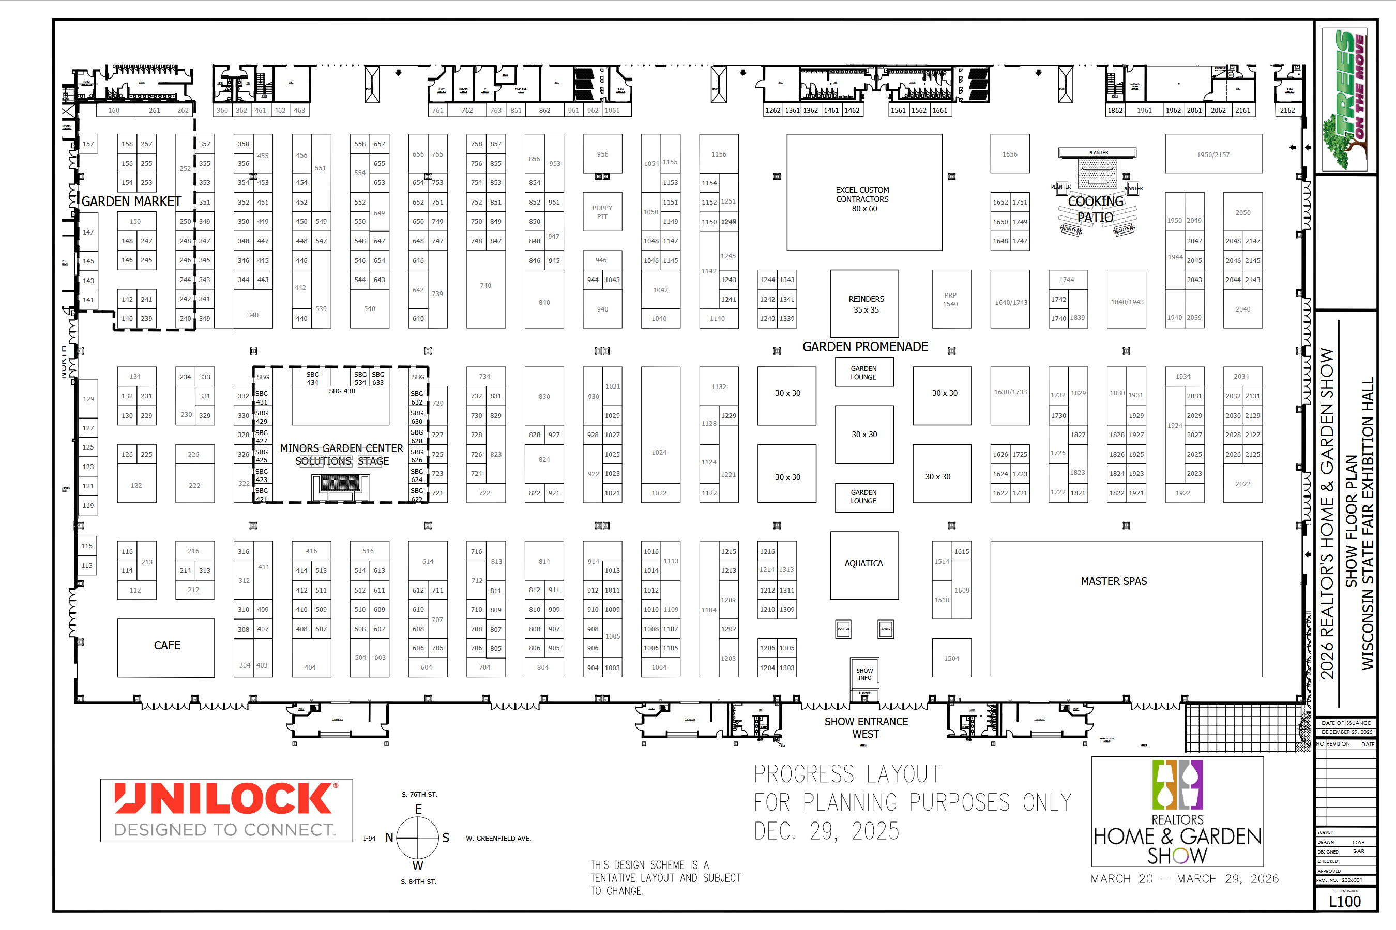
Greater Milwaukee Association of REALTORS®
    All 3 halls
    Before pandemic
    Only 5 other shows:
      Milwaukee Boat Show
      Milwaukee Auto Show
      Holiday Folk Fair International
      USJN Basketball Tournaments
      Lowrider Supershow

Slide 18
Greater Milwaukee Association of REALTORS®
    Booth Revenue
        2026: $667,530 (311 Exhibitors)
        2025: $576,390 (263 exhibitors)
    Sponsorships
        2026: $64,450
        2025: $46,200
    Final Income & Expenses Soon
Wifi: Metro_Guest Pwd: SuperNova8534

Slide 19
Greater Milwaukee Association of REALTORS®
    VIP Tickets
    56,700 VIP tickets sold
    311 members purchased VIP Tickets (5 non-members)
    5,322 Tickets were downloaded
    3,289 Tickets scanned at entry
    Only 5.8% redemption rate (typically 9%)
Wifi: Metro_Guest Pwd: SuperNova8534

Slide 20
Greater Milwaukee Association of REALTORS®
    Attendance
    2026: 10,500
    2025: 14,300
    Exhibitors were mostly very happy with the quality of their leads, and asked for the same space next year
    We seem to be in a new post-pandemic world
Wifi: Metro_Guest Pwd: SuperNova8534

Slide 21



Greater Milwaukee Association of REALTORS®
Chris Lambrou, CEO
Metro, MLS Update
Wifi: Metro_Guest Pwd: SuperNova8534

Slide 22
Greater Milwaukee Association of REALTORS®
Old Business
.
New Business
None
Wifi: Metro_Guest Pwd: SuperNova8534

Slide 23
Upcoming Events
Brewers Bash • Tuesday, April 28th
RPAC Auction • Thursday, May 7th
GMAR Directors Meeting • Tuesday, July 7th 8:30 AM

